Slide 1


Understanding Customer Churn
This presentation explores customer churn modeling, a critical aspect of business strategy. We will delve into data analysis, feature engineering, and model evaluation to predict and understand why customers leave.
by Abdelrahman Seddik

Slide 2

Project Overview and Data Preparation
Project Goal
The primary objective is to build a robust churn prediction model using machine learning techniques. This involves understanding the dataset, preprocessing the data, and evaluating various models.
Initial Data Load
The dataset, "Churn_Modelling.csv," contains 10,000 entries and 14 columns. Initial checks confirm no missing values or duplicate rows, ensuring data quality.

Slide 3






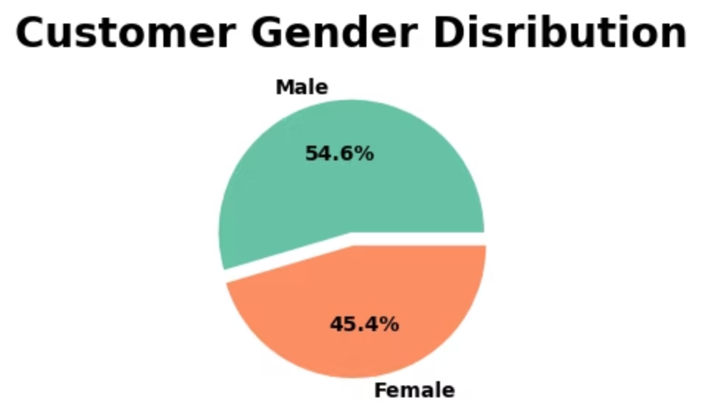
Key Demographic Insights
Age Profile
Customer ages range from 18 to 92, with a mean age of 38.9 years, indicating a diverse age group.
Gender Distribution
The dataset shows a slight majority of male customers (54.6%) compared to female customers (45.4%).
Geographic Spread
Customers are primarily from France (50.1%), followed by Germany (25.1%) and Spain (24.8%).

Slide 4
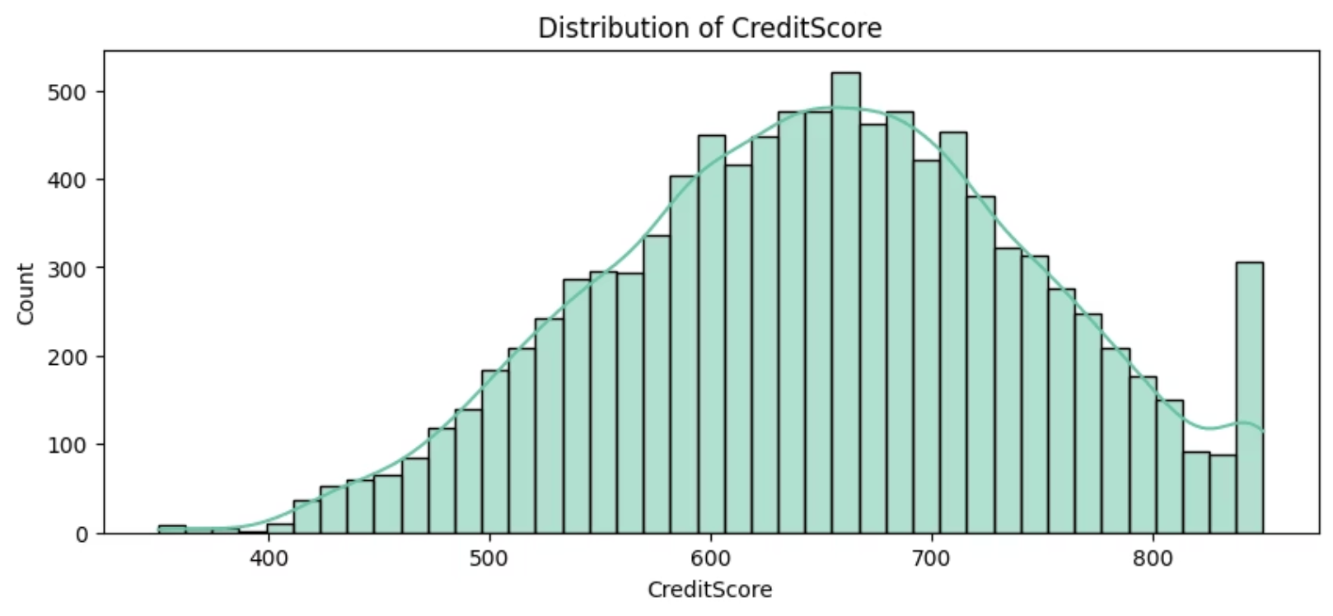
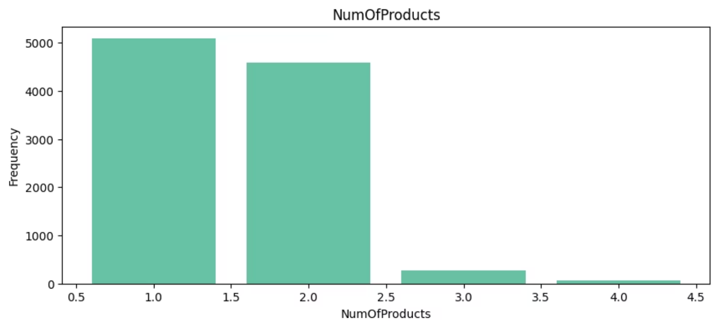
Financial and Product Usage Trends
Credit Score Distribution
Product Ownership
Credit scores range from 350 to 850, with a mean of 650.5, showing a normal distribution.
Most customers own 1 or 2 products (50.8% and 45.9% respectively), with fewer owning 3 or 4 products.

Slide 5
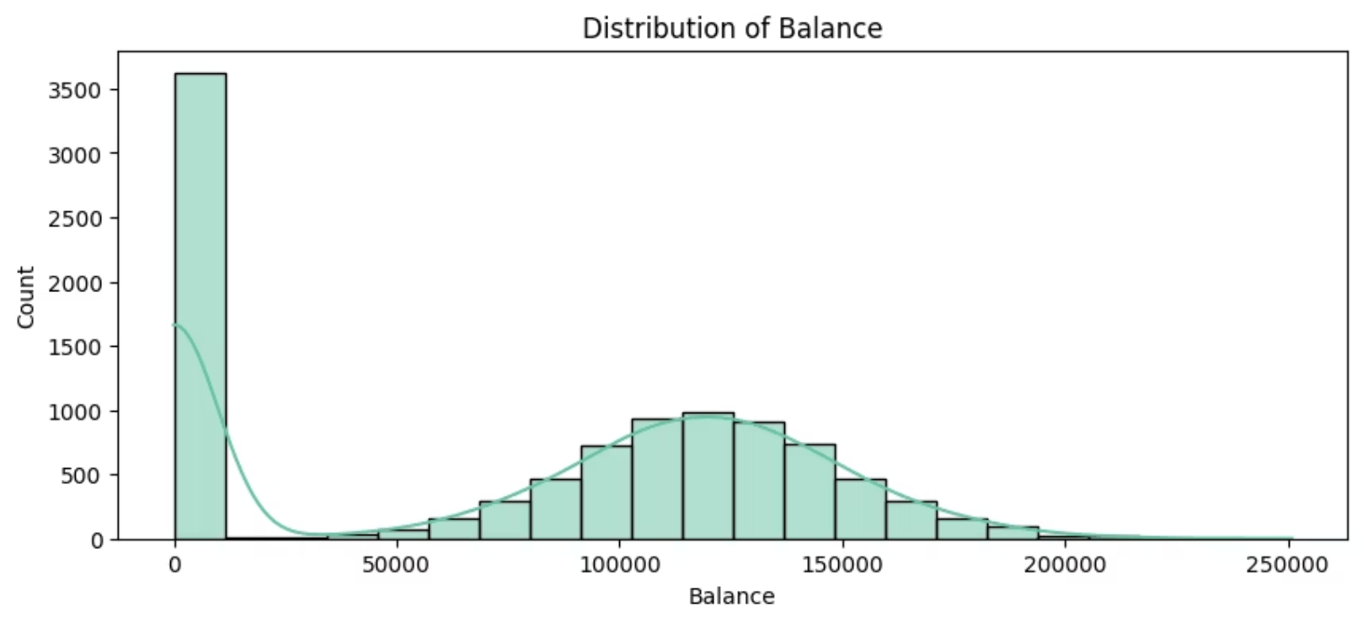
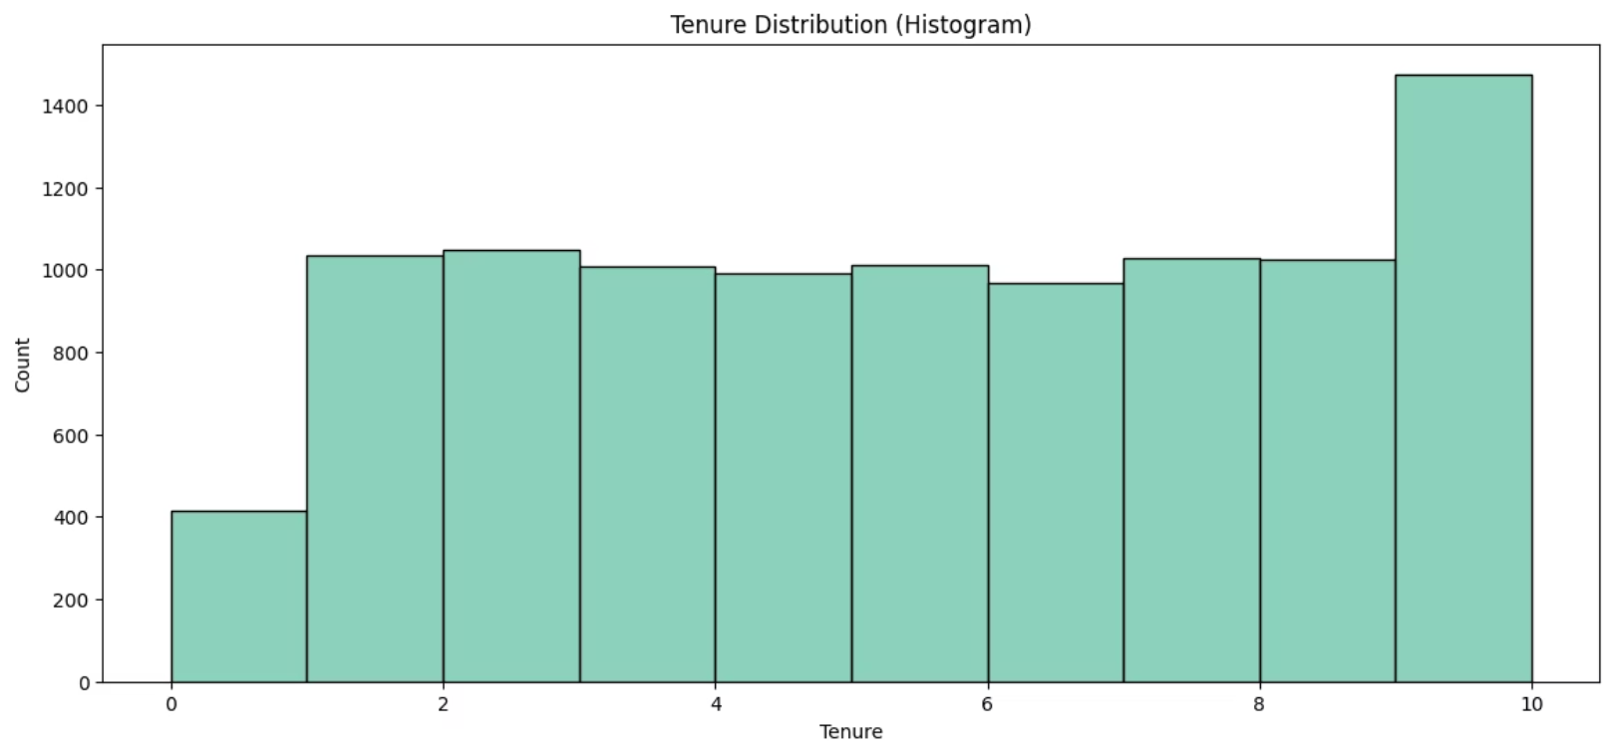
Customer Tenure and Balance Analysis
Tenure Distribution
Balance Distribution
Customer tenure ranges from 0 to 10 years, with a relatively even distribution across most years, except for fewer customers at 0 and 10 years.
Customer balances vary widely, with a significant number having zero balance, suggesting different customer segments.

Slide 6
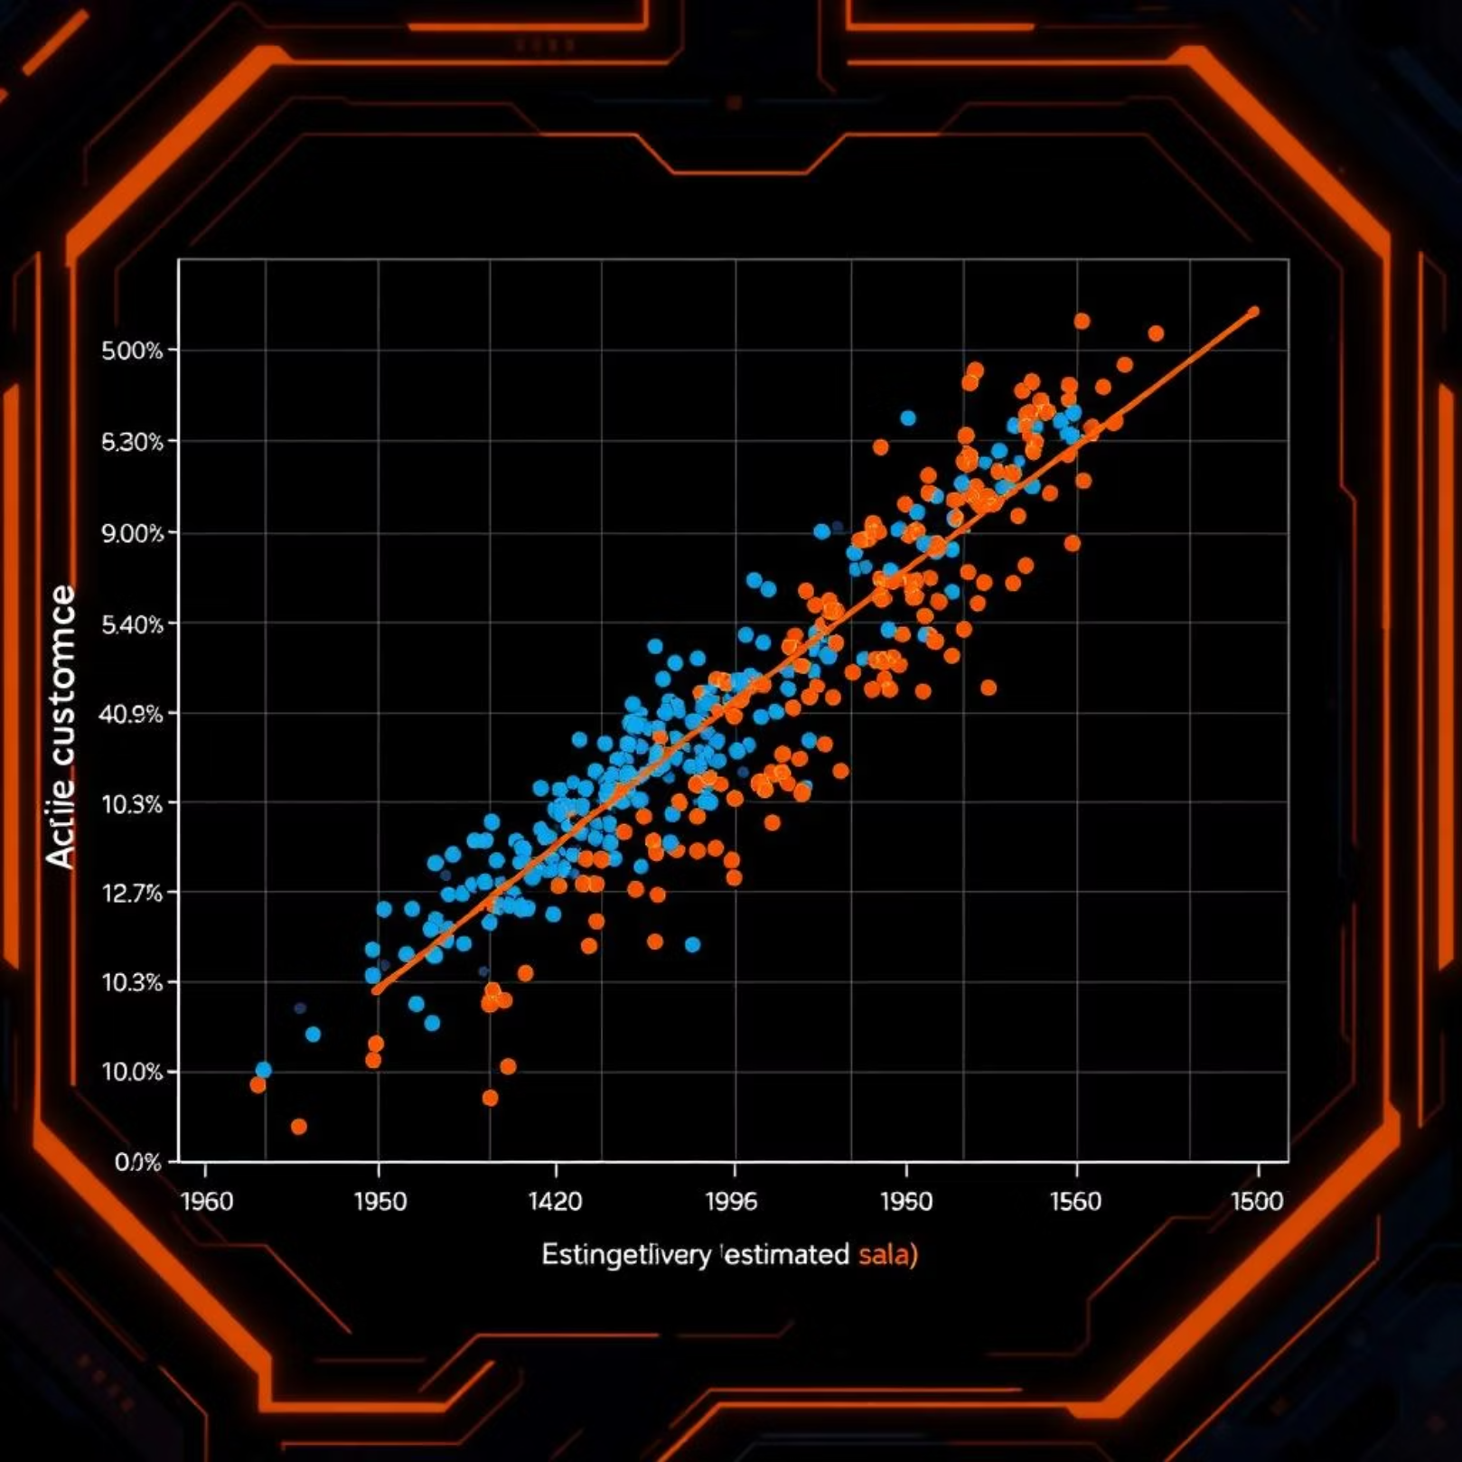
Estimated Salary vs Balance by Churn
The scatter plot visualizes the relationship between customer balance and estimated salary, highlighting those who have churned. This helps identify if specific ranges of balance or salary contribute to customer attrition. For instance, customers with very low or zero balances, regardless of salary, might exhibit a higher propensity to churn.

Slide 7
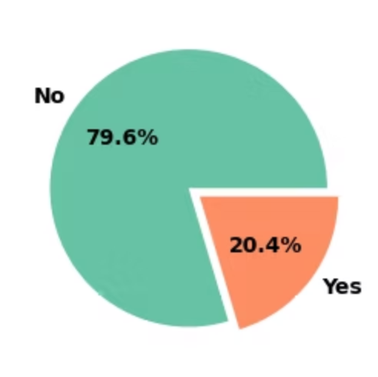
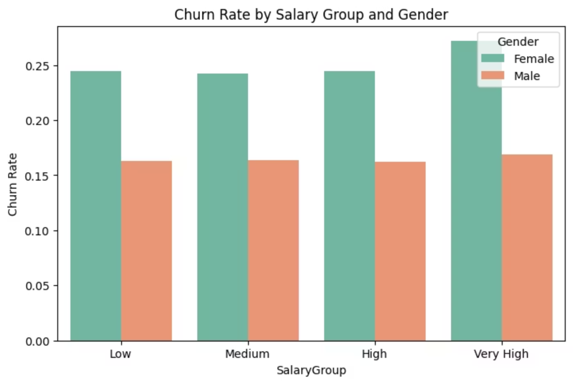
Churn Rate Overview
Overall Churn Rate
Churn by Salary Group and Gender
The dataset indicates that 20.4% of customers have exited, while 79.6% remain active. This imbalance is crucial for model training.
Analysis shows that churn rate varies across salary groups and gender, with females generally having a higher churn rate across all salary tiers.

Slide 8
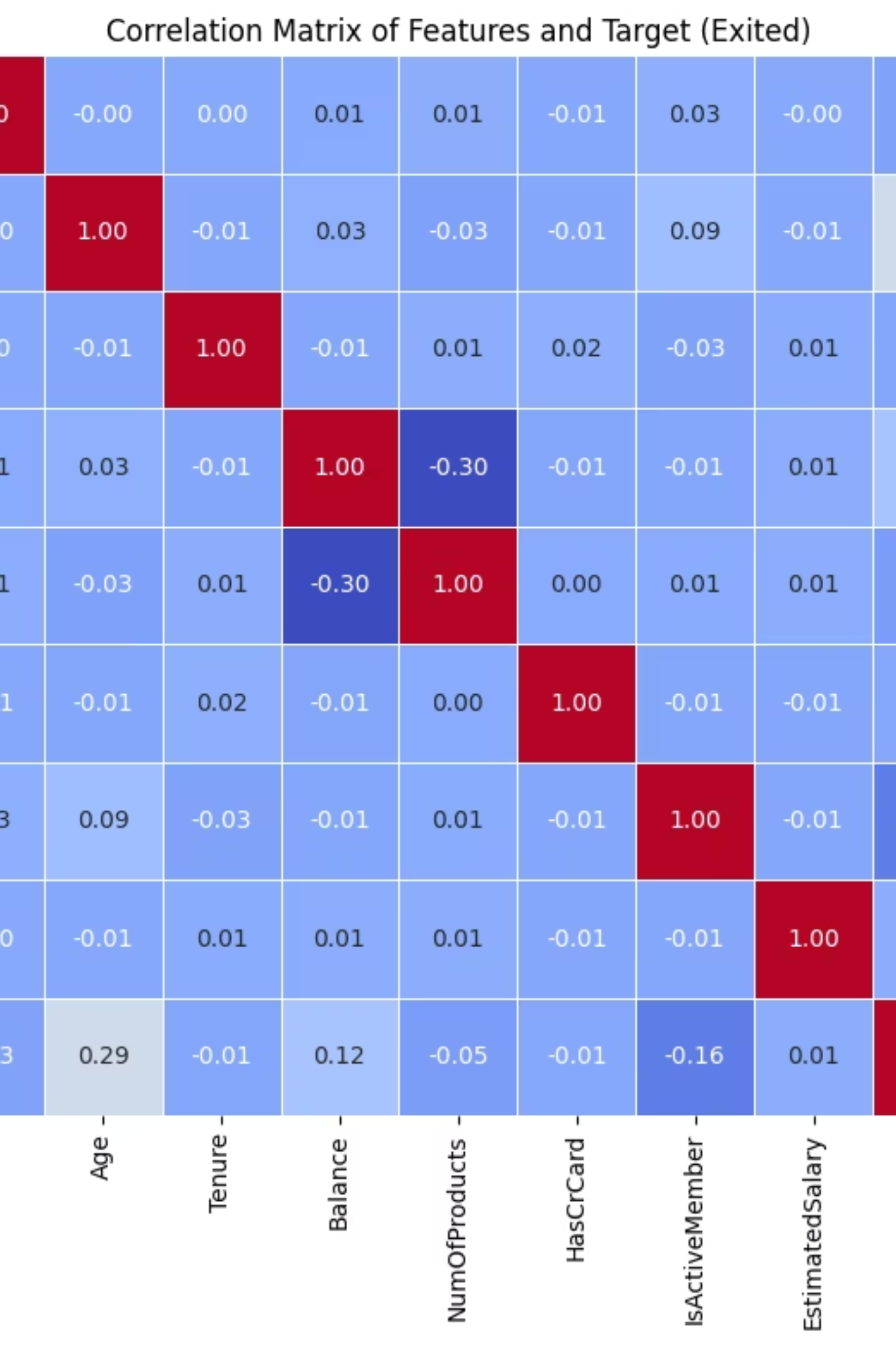
Feature Correlation and Impact on Churn
A correlation matrix reveals relationships between numerical features and the 'Exited' target variable. Age and Balance show a notable positive correlation with churn, indicating older customers and those with higher balances are more likely to churn.

Slide 9

Model Performance and Next Steps
Logistic Regression
Achieved an accuracy of 78.9%, with a precision of 0.39 and recall of 0.07 for churned customers.
Support Vector Classifier (SVC)
Showed an accuracy of 79.7%, but struggled with predicting churned customers (precision and recall of 0.00).
K-Nearest Neighbors (KNN)
Resulted in an accuracy of 77.0%, with low precision (0.26) and recall (0.07) for churned customers.

